Slide 1
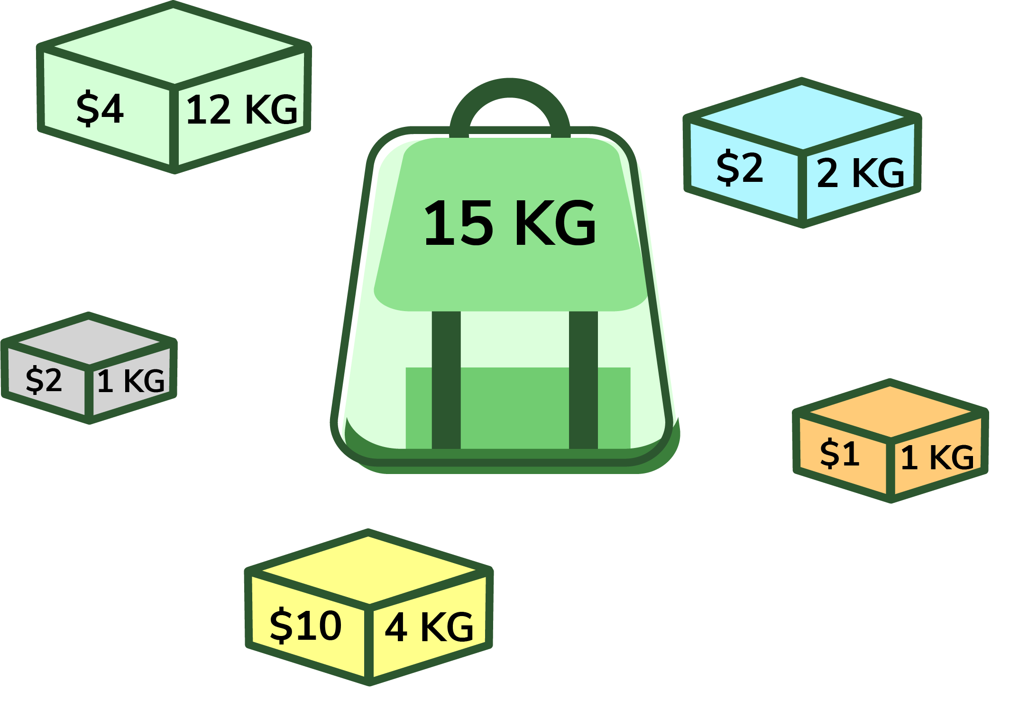
0/1 Knapsack Problem
Maximizing Value Within a Limit
Farjan Ahmmed
232-35-738

Slide 2
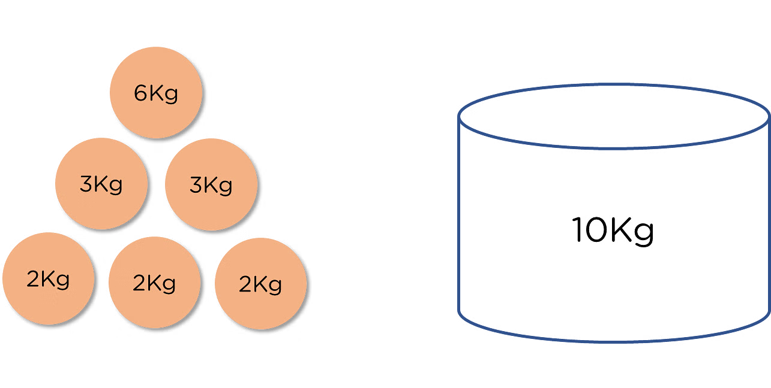
Introduction
What is the 0/1 Knapsack Problem?
The 0/1 Knapsack Problem is a decision-based optimization problem where you must choose a set of items to maximize value without exceeding a weight limit.
Key Points:
You have n items with a weight and a value and a knapsack with a
weight limit.
Goal is to maximize the total value without exceeding W.
The "0/1" means each item can be either taken (1) or not taken (0)—no fractions allowed

Slide 3




Real-Life Applications of 0/1 Knapsack
Business & Project Management
Selecting the most valuable projects within a fixed budget.
Allocating limited resources to maximize profit.
Finance & Investment
Choosing the best stocks or investments within a limited budget.
Optimizing asset allocation to get the highest returns.
Computer Science & Data Storage
Optimizing memory or disk space usage.
Selecting files for backup while considering storage limits.
Logistics & Transportation
Packing goods efficiently in trucks, ships or airplanes.
Choosing the best combination of packages for delivery.

Slide 4
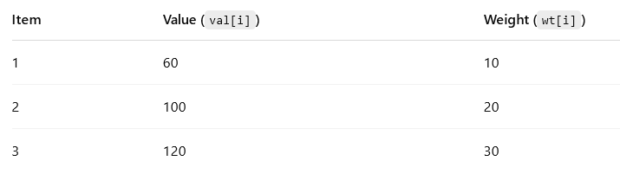
Problem Statement (Mathematical Formulation)
We are given -
n items 📦
Each item has a value 💰 val[i] and weight wt[i]
A knapsack with maximum capacity W ⚖️
🎯 Goal : Maximize total value without exceeding the limit
Formulation –
Maximize :
Σ val[i] × x[i] (i = 1 to n)
Subject to :
Σ wt[i] × x[i] ≤ W
Where :
x[i] ∈ {0, 1}

Slide 5
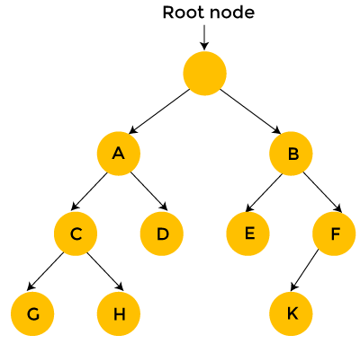
Brute Force Approach (Inefficient)
Try all possible combinations of items
For each combination, check if total weight ≤ W
From valid combinations, pick the one with maximum total value
🧠 Why it’s inefficient -
There are 2ⁿ possible combinations
Time Complexity: O(2ⁿ)
Becomes very slow when the number of items is large
⚠️ Example :
For just 20 items → 2²⁰ = 1,048,576 combinations!

Slide 6
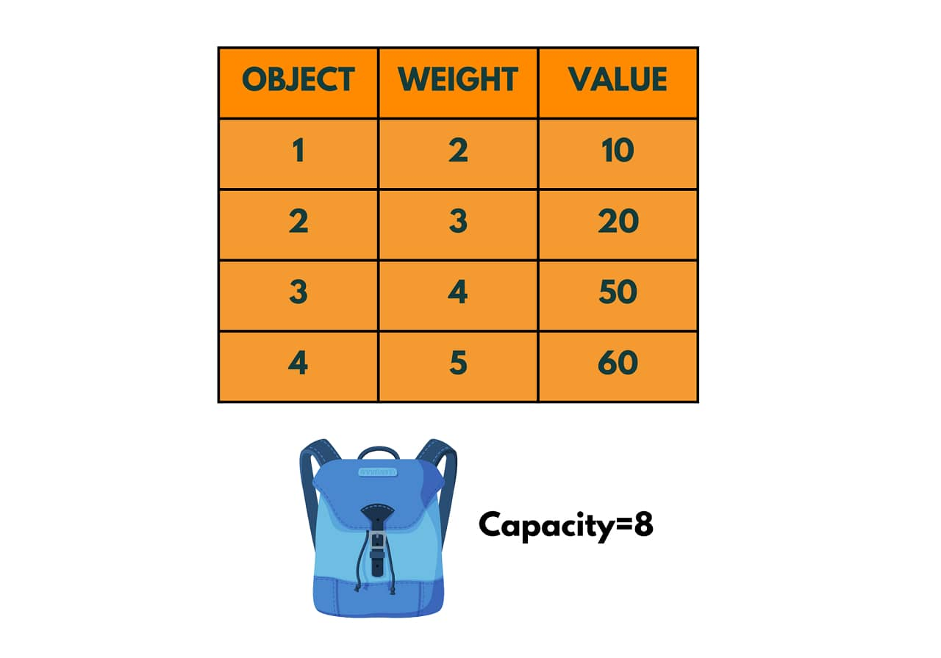
Dynamic Programming Approach (Efficient Solution)
✅ Avoids checking all combinations like brute force ✅ Stores results of subproblems to avoid repeating calculations
Idea:
Use a 2D table dp[i][w]
i = item index (1 to n)
w = current weight capacity (0 to W)
Meaning of dp[i][w] -
Maximum value that can be achieved using the first i items and weight limit w
Time Complexity -
O(n × W) — much faster than brute force!
📌 Dynamic Programming gives the optimal solution in a reasonable time, even for large inputs.

Slide 7
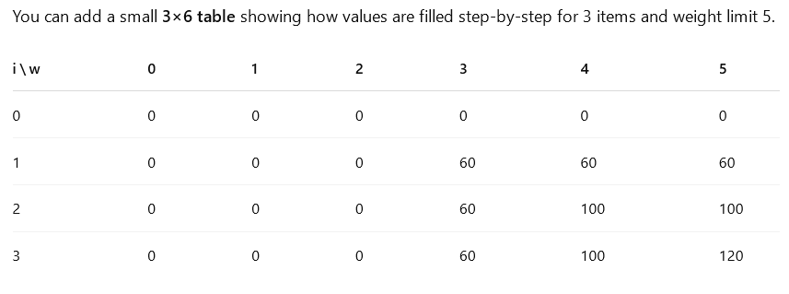
DP Table – How It Works
We build a 2D table dp[n+1][W+1] where -
Rows represent items (0 to n)
Columns represent weight limits (0 to W)
Filling the table -
For each item i and weight w:
If wt[i] > w: ➤ Can’t take the item → dp[i][w] = dp[i-1][w]
Else: ➤ Choose the better option: Take it or skip it → dp[i][w] = max(dp[i-1][w], val[i] + dp[i-1][w - wt[i]])
📌 This shows the table being updated as each item is considered.

Slide 8
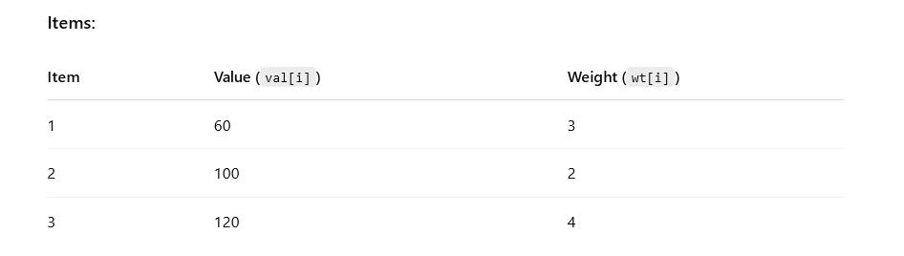
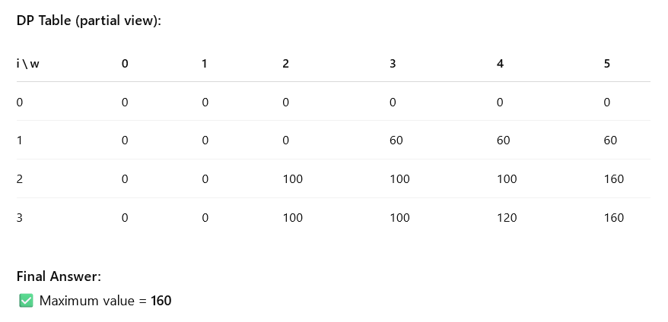
Solving 0/1 Knapsack using DP
Let’s take:
n = 3 items
W = 5 (maximum capacity)
📝 We select Item 2 (100) and Item 1 (60) to get the best total value without exceeding weight limit.

Slide 9


Time and Space Complexity
🕒 Time Complexity -
O(n × W) ➤ n = number of items ➤ W = maximum weight capacity
Efficient for moderate values of n and W
Much better than brute force (O(2ⁿ))
💾 Space Complexity -
O(n × W) for standard 2D DP table
Can be optimized to O(W) using a 1D array (space-optimized version)

Slide 10
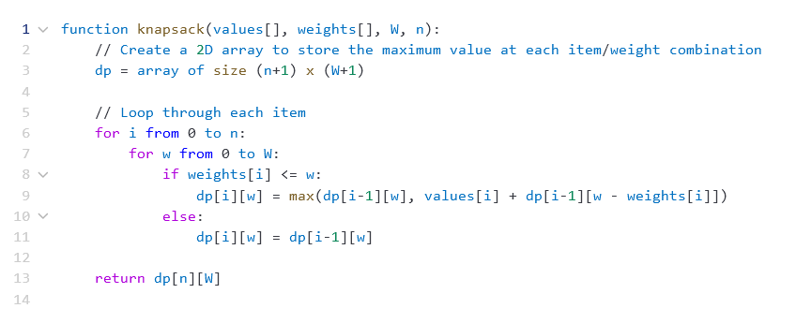
Pseudocode: A Step-by-Step Guide

Slide 11
Limitations and Variants
🚫 Limitations :
Only works when items are not divisible
Not suitable when items can be taken in fractions
Performance depends on size of W (can be slow for very large capacities)
🔄 Variants :
Fractional Knapsack ➤ Items can be broken into parts ➤ Solved using Greedy Algorithm
Bounded Knapsack ➤ Limited copies of each item
Unbounded Knapsack ➤ Unlimited number of each item can be chosen

Slide 12
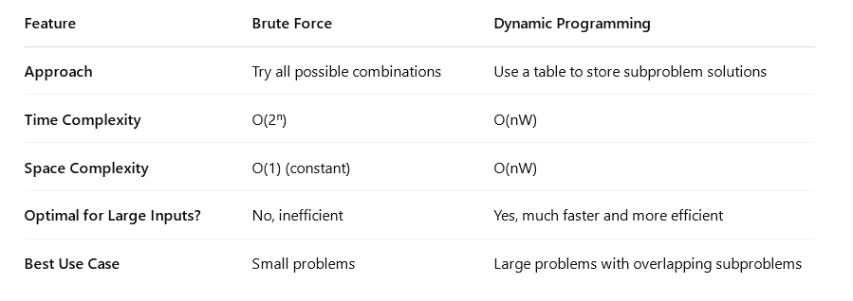
Brute Force vs Dynamic Programming

Slide 13

Conclusion
🔹 Key Takeaways:
0/1 Knapsack is a classic optimization problem solved with Dynamic Programming
Helps select the best combination of items within constraints
🔹 Applications:
Used in resource allocation, project selection, cargo loading and more
🔹 Variants:
Fractional, Bounded, and Unbounded Knapsack address different constraints and use cases
✅ Conclusion:
0/1 Knapsack is a powerful tool for real-world optimization problems!

Slide 14

Thank You

